Slide 1
Enhancing Semantic Parsing Accuracy through Diverse Generation and Uncertainty Quantification: A Dual-Component Approach
Alex Najera, Vishnu Yarabarla

Slide 2
Introduction
Existing semantic parsers often struggle with the ambiguity and complexity inherent in natural language instructions or LLM outputs. This research proposes a semantic parsing architecture involving two complementary components to improve translation accuracy within task-oriented domains.
Weak Supervision
Uncertainty Quantification

Slide 3
Background

Slide 4
Why is Semantic Parsing Important?
Semantic parsing is essential for bridging the gap between natural language and executable actions in task-based systems. However, traditional parsers often fail when dealing with complex language or limited context. Their performance relies on their ability to precisely parse them into executable actions.

Slide 5
AMA Paper
Effectively used weak supervision to improve prompting accuracy, with a performance lift on 10.2%
Varied in-context demonstrations from a limited LLM proved to work effectively for prompting
Believed to be a relevant an effective to boost semantic parsing performance

Slide 6
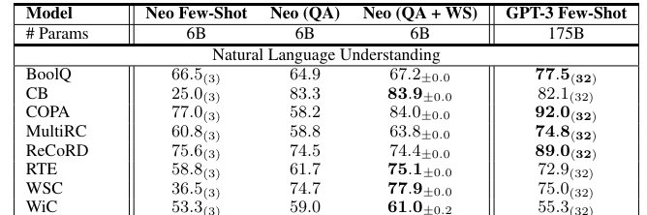
AMA Paper
Specifically for Natural Language Understanding, Question-Answer formatted + Weak Supervision provided a boost in performance

Slide 7
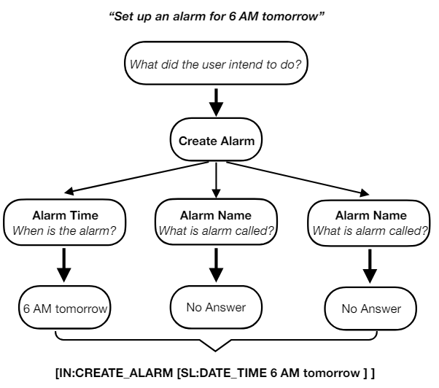
ZeroTOP Paper
ZeroTOP is a zero-shot task-oreinted parsing method in which a semantic parsing problem is decomposed in QA problems
For each problem, prompt the LLM to construct its target, observe its confidence per question

Slide 8
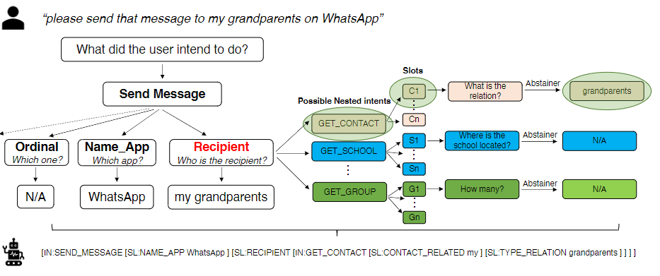
ZeroTOP

Slide 9
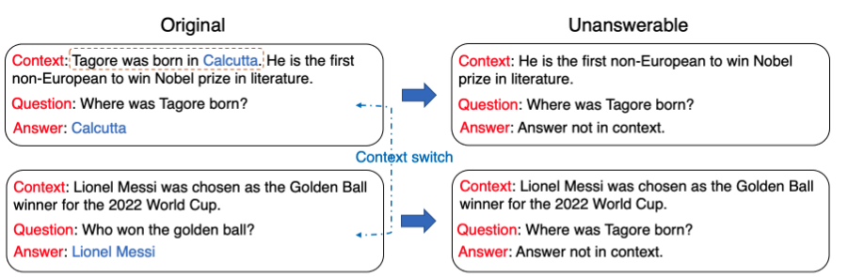
LLMs can attain reasonable generalization on a diverse set of NLP tasks including text classification, question answering, etc.
What happens if there isn’t enough context? - ZEROTOP also trains a model to identify any unanswerable questions and abstain from prediction.
If we can implement a threshold to determine if a question doesn’t have enough information to be answered, we can simply ask for more clarification instead of trying to give an answer with incomplete data.

Slide 10
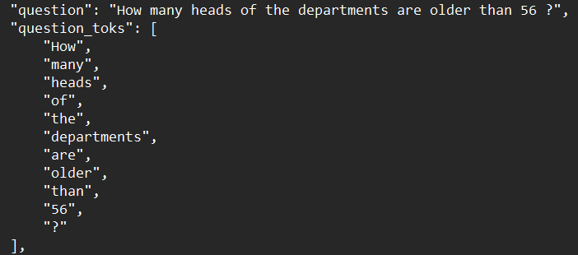
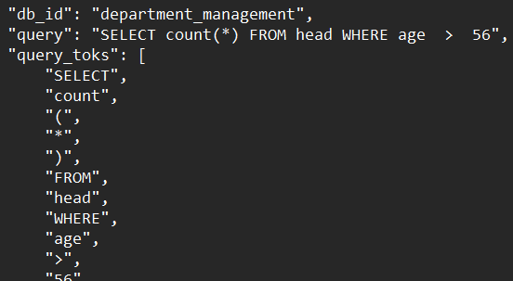
Dataset
Spider Dataset
- train_spider.json
# Training Examples: 7000
# Databases: 140
- train_others.json
# Training Examples: 1659
# Databases: 6
- dev.json
# Training Examples: 1034
# Databases: 20
- tables.json
# Databases: 166
- dev_gold.sql
- train_gold.sql
- database/
- README.txt

Slide 11
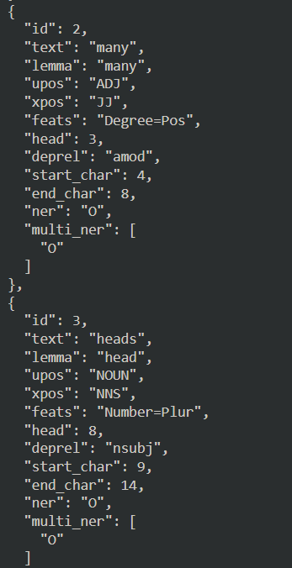
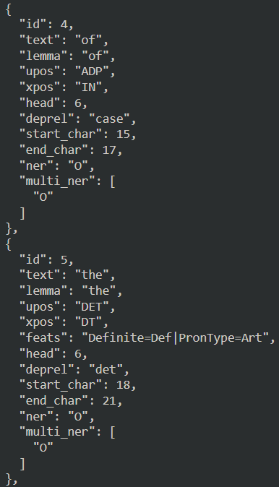
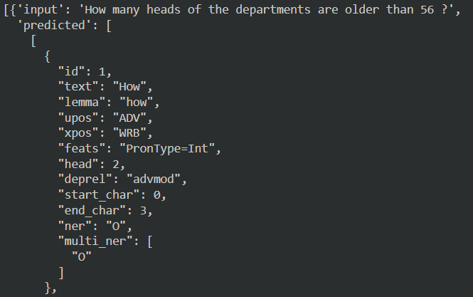
Stanford (Stanza) Parsing Results Example

Slide 12
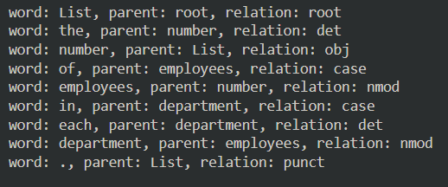
Dependency Parsing Example
Dependency Parsing is done to determine the relationship between the words in the sentence
Important Factors: Who, What, When, Where, and Why

Slide 13
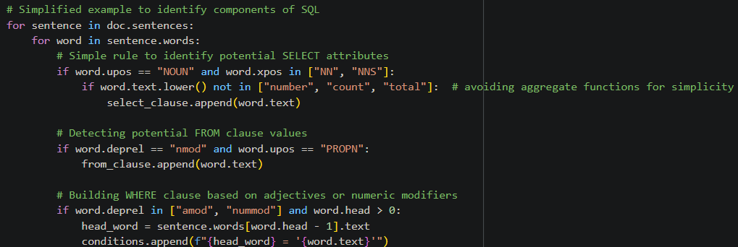
Generating Possible SQL candidates
Stanford Parsing & Dependency Parsing
-> Use parts of speech and dependencies to determine our SQL queries
Thought Process: Who (noun) does (verb) what to whom (object)?

Slide 14
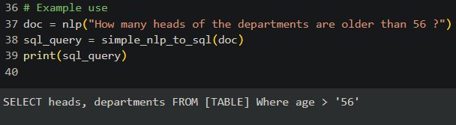
Text to SQL Example

Slide 15
Weak Supervision
Heuristics:
Reward SQL queries that use keywords likely to be in the correct query
Simplicity Bias - Penalize overly complex queries
Check if query terms appear in the SQL (simple context matching)
Score each SQL candidate and select the one with the highest score.

Slide 16
Uncertainty Quantification
For each parsing outcome, the model generates a probability score that reflects its model’s confidence
System checks the confidence based on historical performance
When confidence level of a parsing result falls below the threshold, system automatically initiates the re-parsing process
User feedback: if confidence continues to remain low, system prompts user for clarification

Slide 17
Testing and Results
Utilized various existing parsers (AllenNLP, StanfordNLP, SpaCy) for our default control group
Difficulties in accurately scoring and comparing diverse parsings due to the subjective nature of certain queries
The enhancements provided more robust handling of certain query types but struggled with very complex or poorly structured inputs
Similar results throughout various parsers

Slide 18
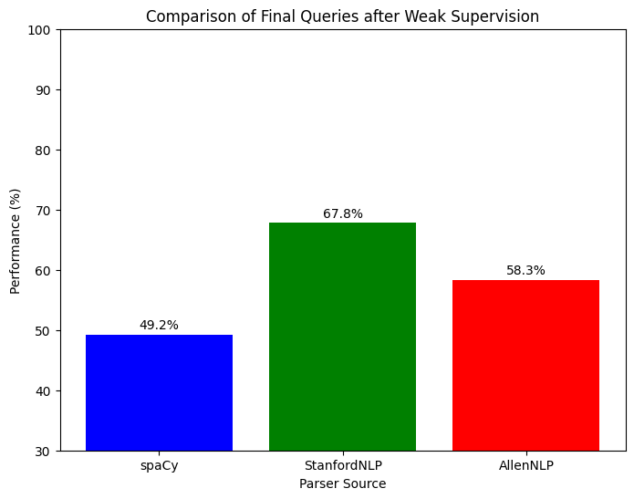
Results After Weak Supervision

Slide 19
Future Work
A significant limitation was with the dataset, limited to SQL query labels
Free version of Google Colab limited GPU usage
Creating our own semantic parser proved challenging and we needed to focus on improving existing methods
Would need further development of the scoring mechanisms for weak supervision and exploration of more sophisticated models for uncertainty quantification

Slide 20
Reference
[1] Ask Me Anything: A simple strategy for prompting language models
[2] ZEROTOP: Zero-Shot Task-Oriented Semantic Parsing using Large Language Models

Slide 21
Thank You
Q&A

